Slide 1



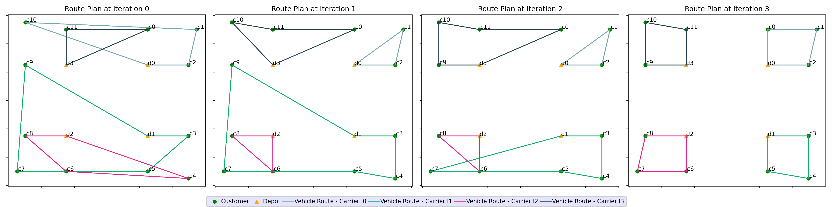
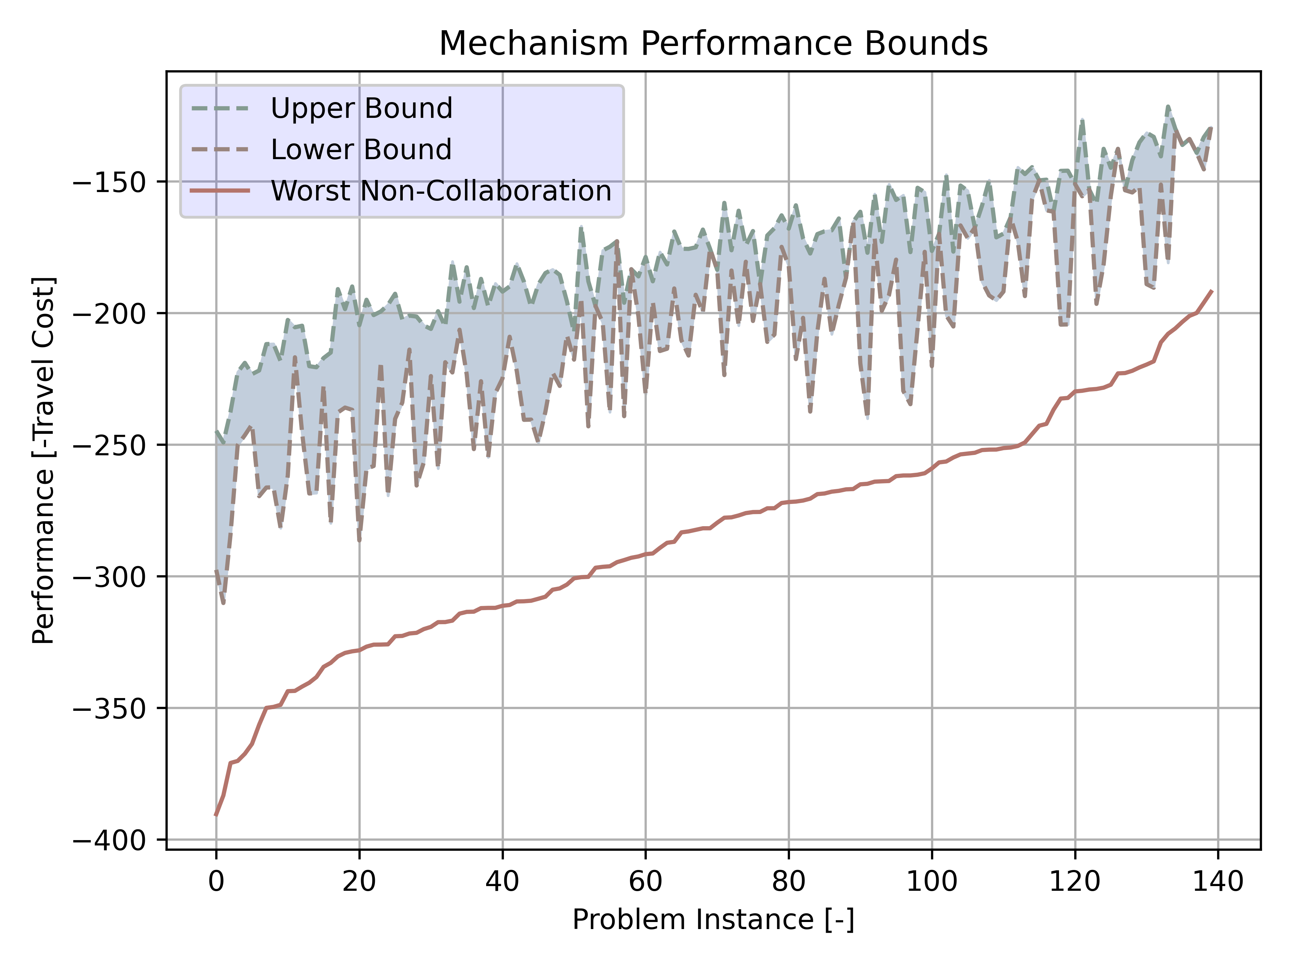
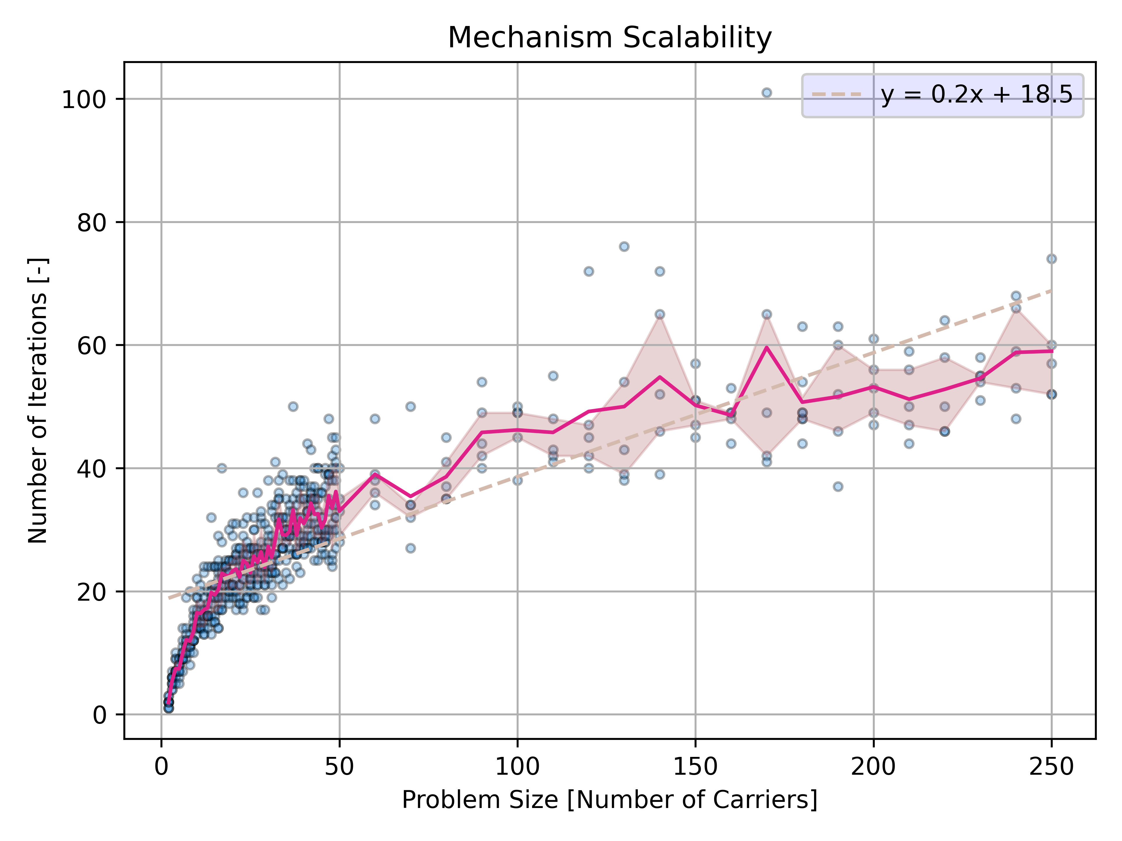
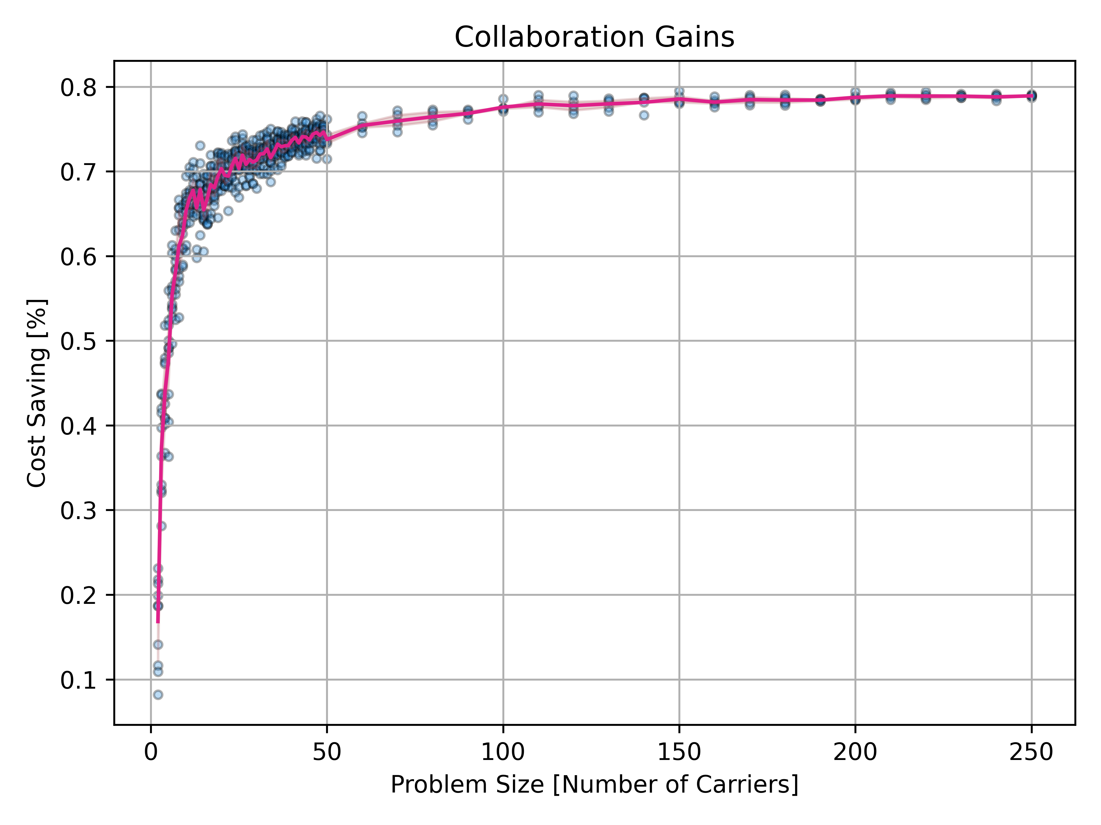
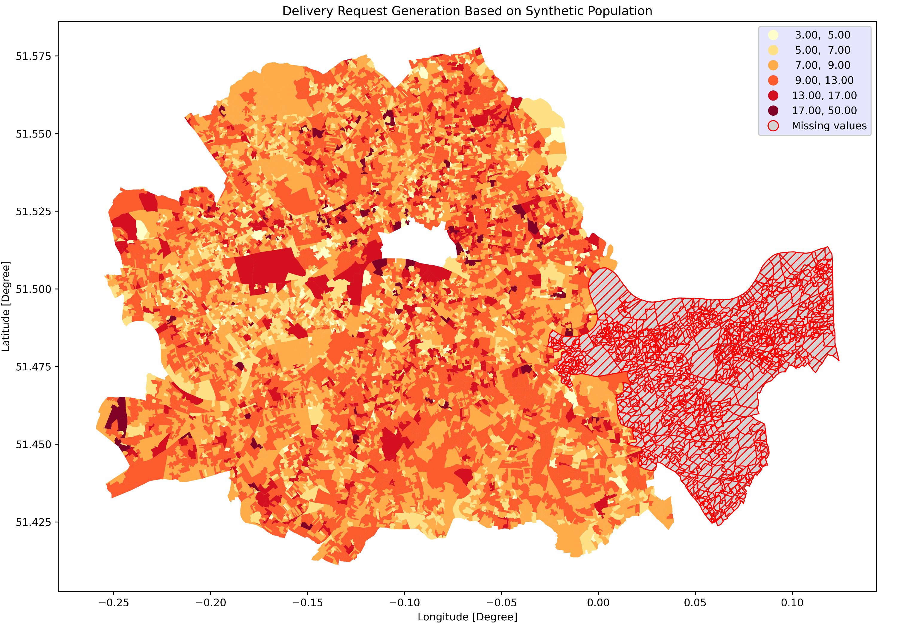
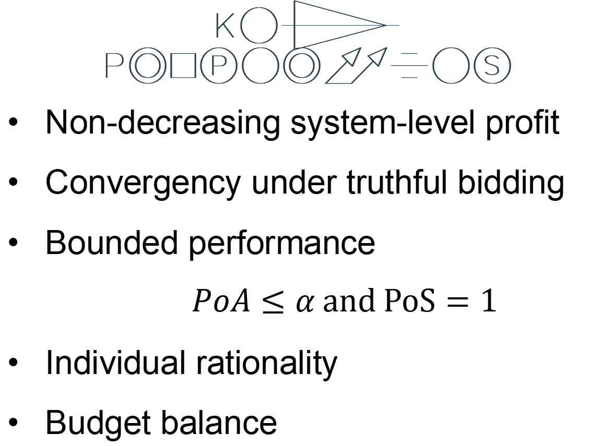
Last-Mile Collaboration
Iterative Mechanism with Performance Guarantees
Keyang Zhang¹, Jose Escribano-Macias¹, Dario Paccagnan², Panagiotis Angeloudis¹
[1] Centre for Transport Studies, Imperial Collage London
[2] Department of Computing, Imperial College London
Contact: keyang.zhang20@imperial.ac.uk
Introduction: Competitive and Fragmented Last-mile Market
The last-mile urban freight market is characterized by
Proliferation of Small Operators
Soaring Fragmentation
Fierce Competition
Super-low Profit Margin
Demanding Customers
These conditions make it difficult for operators (Carriers) to survive and provide level-of-service guarantees.
Uncoordinated vehicle trips result in additional traffic that further exacerbates urban congestion and emissions.
Consolidated – Market dominated by 1-5 major players
Research Gap
Existing models were torn between
profit maximization which entails exponential complexities
simplification which uncertainly undermines profit gains
UK Freight and logistics Market
Research Objective
Design a collaboration mechanism
scalable with problem sizes
achieve bounded performance
Fragmented – Highly competitive market without dominant players
Figure 1 Competition in UK Freight and Logistics Market^{[1]}
Methodology: Algorithmic Mechanism Design
Customer Perspective
Carrier’s Welfare Allocation
Distributed Welfare Game
Learning Dynamics
Convergence to Equilibria
Last-mile Market
Stimulate
Worst-case / Best-case
Carrier Perspective
Customer Reallocation
Collaboration Mechanism
Allocation Rule
Performance Guarantees
Payment Rule
Individual Rationality
Figure 2 Mechanism design paradigm
Budget Balance
Key Properties
Non-decreasing system-level profit
Convergency under truthful bidding
Bounded performance
$$PoA≤α and PoS=1$$
Individual rationality
Budget balance
Figure 3 Illustrative iterative customer (re)allocation process
Agent-based Simulation
Empirical Results
Case study in the inner London area
Realistic customer spatial distribution
Various instance sizes
Up to 250 carriers and 1000 customers
Figure 5 Guaranteed performance region compared against the worst-case non-collaboration
Figure 6 Polynomially increased number of iterations required to termination
Figure 6 Cost savings achieved in various problem sizes
Conclusion
This study proposes an iterative and auction-based mechanism (IAM) for last-mile urban freight collaboration. IAM is individually rational, budge balanced, theoretically convergent and guarantees a non-decreasing and bounded system profit. It scales well and could produce up to 80% cost savings in large-scale instances.
Figure 4 Delivery requests generated in the inner London area
Reference
[1] Mordor Intelligence. (2021) UNITED KINGDOM FREIGHT AND LOGISTICS MARKET - GROWTH, TRENDS, COVID-19 IMPACT, AND FORECASTS (2022 - 2027). Available from: https://www.mordorintelligence.com/industry-reports/united-kingdom-freight-logistics-market-study.

